Slide 1
Process Synchronization and Semaphores
Tahira Alam
University of Asia Pacific

Slide 2
Background
Concurrent access to shared data may result in data inconsistency
Maintaining data consistency requires mechanisms to ensure the orderly execution of cooperating processes

Slide 3
Consumer-Producer problem
A producer process produces information that is consumed by a consumer process.
One solution: producer and consumer use shared memory.
allow producer and consumer processes to run concurrently
available a buffer of items that can be filled by the producer and emptied by the consumer.
The producer and consumer must be synchronized, so that the consumer does not try to consume an item that has not yet been produced.

Slide 4
Bounded and Unbounded Buffer
The unbounded buffer places no practical limit on the size of the buffer
The bounded buffer assumes a fixed buffer size.

Slide 5
Solution (Producer)
while (count == BUFFER.SIZE)
; // do nothing
// add an item to the buffer buffer[in] = item;
in = (in + 1) % BUFFER.SIZE;
++count;

Slide 6
Solution(Consumer)
while (count == 0)
; // do nothing
// remove an item from the buffer item = buffer[out];
out = (out + 1) % BUFFER.SIZE;
--count;

Slide 7
Solution(Explanation)
The shared buffer is a circular array. ‘in’ points to the next free position, ‘out’ points to the first full position. ‘count’ is the number of elements currently in the buffet. When, count==0, that means buffet is empty and when count == buffet size, that means buffet is full. The array is a circular array.

Slide 8


Problem????
Although both the producer and consumer routines are correct separately, they may not function correctly when executed concurrently.

Slide 9
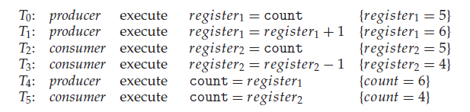
So…..What can happen?

Slide 10
Race Condition
A situation like this, where several processes access and manipulate the same data concurrently and the outcome of the execution depends on the particular order in which the access takes place, is called a race condition.

Slide 11
The Critical-Section Problem
Consider a system consisting of n processes {P0, P1, ..., Pn−1}. Each process has a segment of code, called a critical section, in which the process may be changing common variables, updating a table, writing a file, and so on. The important feature of the system is that, when one process is executing in its critical section, no other process is to be allowed to execute in its critical section.

Slide 12
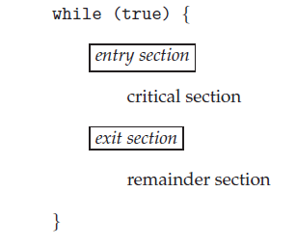
General Structure of a Code Having Critical Section
Each process must request permission to enter its critical section. The section of code implementing this request is the entry section. The critical section may be followed by an exit section. The remaining code is the remainder section.

Slide 13
Requirements for Solution for a Critical-Section Problem
Mutual Exclusion
Progress
Bounded Waiting

Slide 14

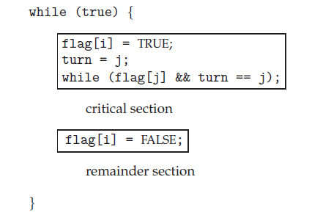
Paterson’s Solution to Bounded Buffer System
Applicable for Two
Processes
Suppose Process
i and j (numeric values: 0,1)

Slide 15
Hardware Solution
Well there are some hardware solutions, but they are too much complicated.
No worries, we have Semaphore!!!!!

Slide 16
Semaphore
Synchronization primitive like condition variables
• Semaphore is a variable with an underlying counter
• Two functions on a semaphore variable
– Up/post increments the counter
– Down/wait decrements the counter and blocks the calling thread if the resulting value is negative
• A semaphore with init value 1 acts as a simple lock (binary semaphore = mutex)

Slide 17
Semaphore Example
sem_t m;
sem_init(&m, 0,1);//initialize semaphore to X; what should X be?
sem_wait(&m);
// critical section here
sem_post(&m);

Slide 18
Solving the Producer-consumer Problem using Semaphores
Need two semaphores for signaling
One to track empty slots, and make producer wait if no more empty slots
One to track full slots, and make consumer wait if no more full slots
• One semaphore to act as mutex for buffer

Slide 19
Solving the Producer-consumer Problem using Semaphores(2)
int main(int argc, char *argv[]) {
// ...
sem_init(&empty, 0, MAX); // MAX buffers are empty to begin with ...
sem_init(&full, 0, 0); // ... and 0 are full
sem_init(&mutex, 0, 1); // mutex=1 because it is a lock
// ...
}

Slide 20
Solving the Producer-consumer Problem using Semaphores(3)
sem_t empty;
sem_t full;
sem_t mutex;
void *producer(void *arg) {
int i;
for (i = 0; i < loops; i++) {
sem_wait(&empty);
sem_wait(&mutex);
put(i);
sem_post(&mutex);
sem_post(&full);
}
}
void *consumer(void *arg) {
int i;
for (i = 0; i < loops; i++) {
sem_wait(&full);
sem_wait(&mutex);
int_ tmp = get();
sem_post(&mutex);
sem_post(&empty);
printf("%d\n", tmp);
}
}

Slide 21
Reader Writer Problem
One database
Some processes want to read only (Readers)
Some processes want to read and write (Writers)
Problem:
Reader and Reader→ok
Reader and writer → not ok
Writer and reader → not ok
Writer and Writer → not ok

Slide 22

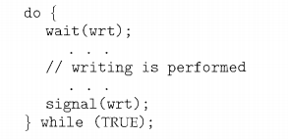
Writer

Slide 23
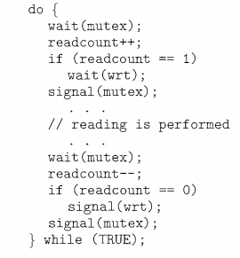
Reader

Slide 24
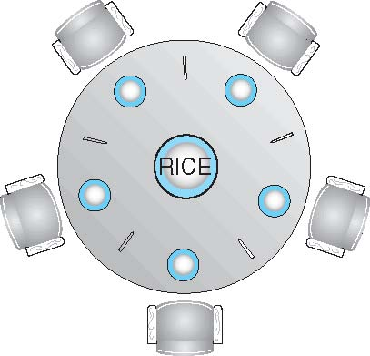
Dining-Philosophers Problem
Shared data
Bowl of rice (data set) and need 2 chopsticks
Semaphore chopstick [5] initialized to 1

Slide 25
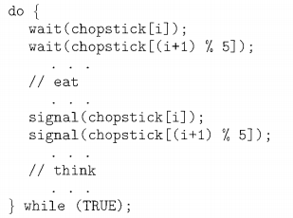
Dining-Philosophers Problem (Cont.)

Slide 26
Thank you!!!!

